Slide 1
Weekly report: Team Project Development
Week number: 04
Date: 21/10/2025
Supervisor: Dr. Marina Blohm
Group members: Luis Urhahn, Ahmed Sallam, Ceren Cetin, Sohil Mansuri
Presenter: Sohil Mansuri

Slide 2
List of content
Task of this week
Update on wind analysis – Weibull-Distribution
Description of the location – Qattinah
Overview of the selected parameters
Roadmap for the proejct development
Sohil Mansuri

Slide 3
1. Tasks of the week
Calculating the Weibull-Distribution
Presenting a detailed overview of the location
Developing an overview of the selected parameters
Roadmap of the sub-tasks for the next weeks
Sohail Mansuri

Slide 4
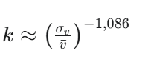
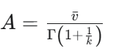
2.1 Update on wind analysis
Wind range [m/s] | Windbins [m/s] | Absolute Frequency (n_i) | Cumulative Distribution Function F(v) | Probability Density Function f(v)
0 - 1 | 0.5 | 139 | 0.0026 | 0.0205
1 - 2 | 1.5 | 1620 | 0.0308 | 0.0429
2 - 3 | 2.5 | 3232 | 0.0615 | 0.0581
3 - 4 | 3.5 | 4374 | 0.0832 | 0.0685
4 - 5 | 4.5 | 4564 | 0.0868 | 0.0748
5 - 6 | 5.5 | 4082 | 0.0777 | 0.0776
6 - 7 | 6.5 | 3682 | 0.0701 | 0.0775
7 - 8 | 7.5 | 3256 | 0.0619 | 0.0752
8 - 9 | 8.5 | 2933 | 0.0558 | 0.0710
9 - 10 | 9.5 | 2754 | 0.0524 | 0.0656
10 - 11 | 10.5 | 2649 | 0.0504 | 0.0595
11 - 12 | 11.5 | 2523 | 0.0480 | 0.0529
12 - 13 | 12.5 | 2521 | 0.0480 | 0.0463
13 - 14 | 13.5 | 2360 | 0.0449 | 0.0399
14 - 15 | 14.5 | 2171 | 0.0413 | 0.0338
15 - 16 | 15.5 | 1998 | 0.0380 | 0.0283
16 - 17 | 16.5 | 1727 | 0.0329 | 0.0234
17 - 18 | 17.5 | 1461 | 0.0278 | 0.0191
18 - 19 | 18.5 | 1277 | 0.0243 | 0.0154
19 - 20 | 19.5 | 1064 | 0.0202 | 0.0122
20 - 21 | 20.5 | 829 | 0.0158 | 0.0096
21 - 22 | 21.5 | 480 | 0.0091 | 0.0075
22 - 23 | 22.5 | 362 | 0.0069 | 0.0058
23 - 24 | 23.5 | 250 | 0.0048 | 0.0044
24 - 25 | 24.5 | 132 | 0.0025 | 0.0033
25 - 26 | 25.5 | 63 | 0.0012 | 0.0025
26 - 27 | 26.5 | 33 | 0.0006 | 0.0018
27 - 28 | 27.5 | 19 | 0.0004 | 0.0013
28 - 29 | 28.5 | 5 | 0.0001 | 0.0010
29 - 30 | 29.5 | 0 | 0.0000 | 0.0007
30 - 31 | 30.5 | 0 | 0.0000 | 0.0005
Parameter | Unit | Number
Number of Measurements | / | 52560
Mean value (bar{v}) | m/s | 8.9581
standard deviation (sigma_v) | m/s | 5.4891
Ratio | / | 0.6128
Form Parameter (k) | / | 1.7022
Gamma-Argument | / | 1.5875
Gamma-Value | / | 0.8922
Scale Parameter (A) | m/s | 10.04
Form Parameter:
Scale Parameter:
[5] [6] [7]
Sohil Mansuri

Slide 5
2.2 Weibull-Distribution
Sohil Mansuri

Slide 6
2.3 Weibull-Distribution - Description
The Shape Parameter k of 1.73 suggests a variable wind characteristic, which is common for onshore locations.
The low k value indicates a broad distribution of wind speeds.
Compared to a more stable wind resource like an offshore location (k range from 2.5 to 3.0), our site experiences more frequent periods of both low and very high wind speeds.
The Scale Parameter A of 10.04 m/s indicates a very good wind resource at the location.
This high value suggests a high mean wind speed and therefore a high energy density.
Such high mean wind speeds are typical for highly exposed sites (e.g. coastal areas, mountain ridges or offshore).
→ The Scale Parameter is usually a bit higher than the average wind speed.
Sohil Mansuri

Slide 7
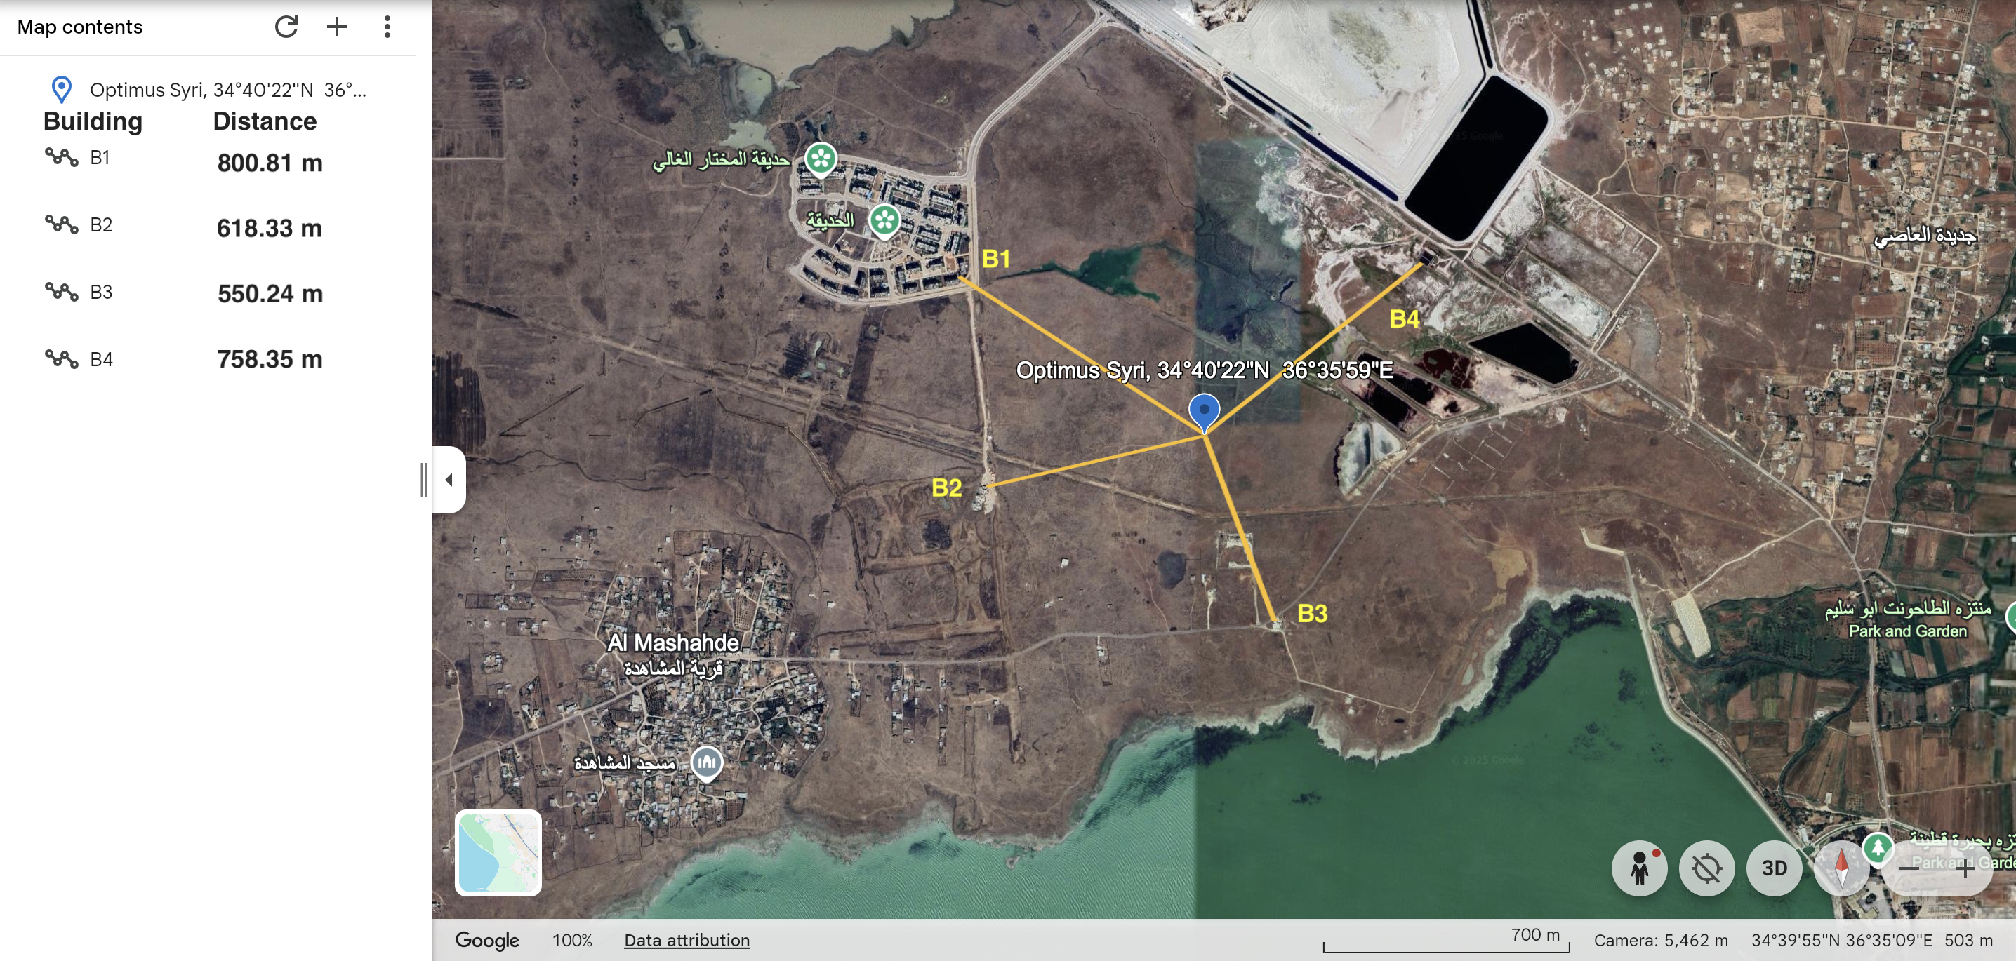
3. Description of the location – Qattinah
[2]
Sohil Mansuri

Slide 8
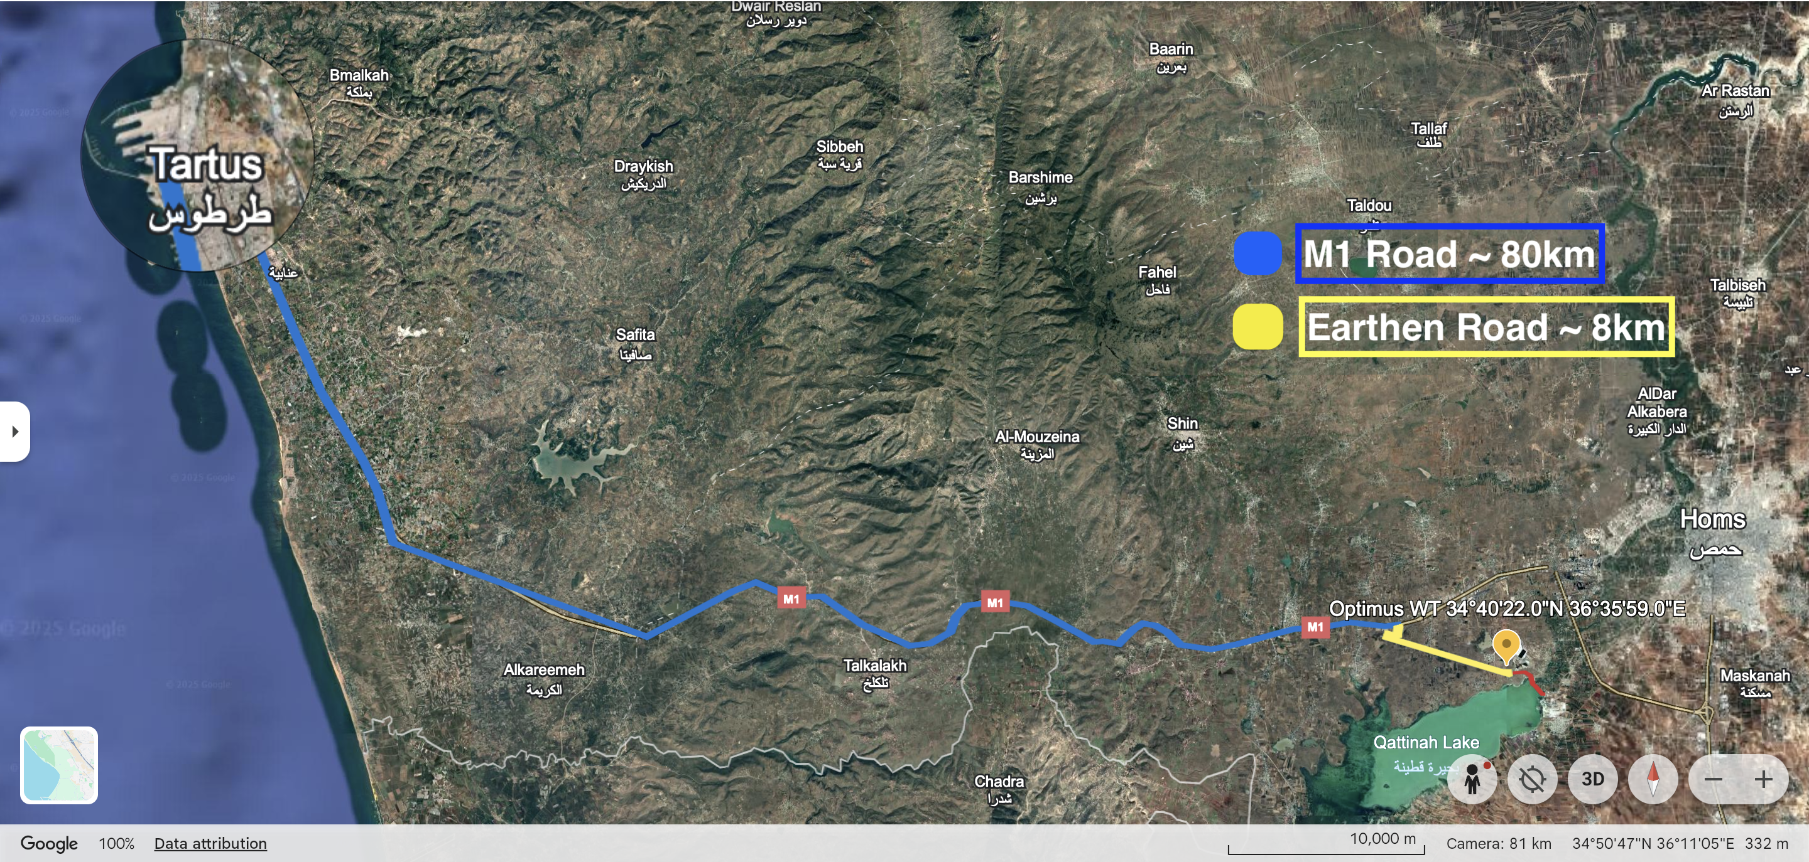
3.1 Overview of connecting road from port
[2]
Sohil Mansuri

Slide 9
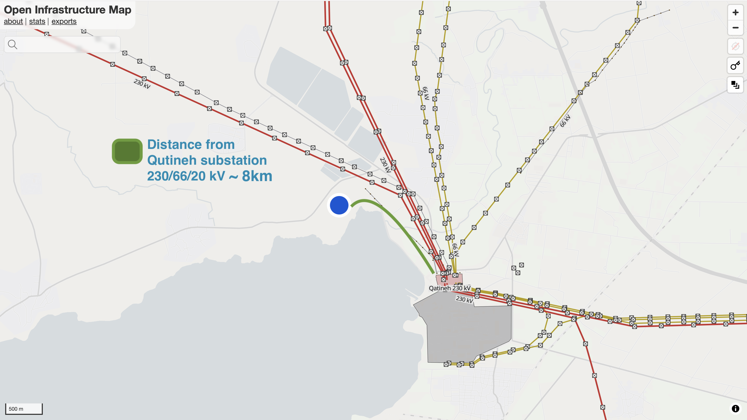
3.2 Distance from Substation
[4]
Sohil Mansuri

Slide 10
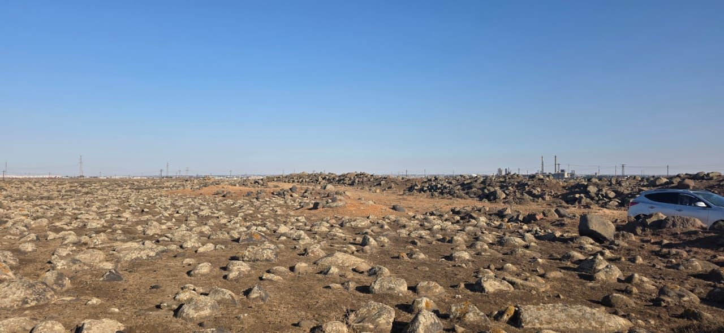
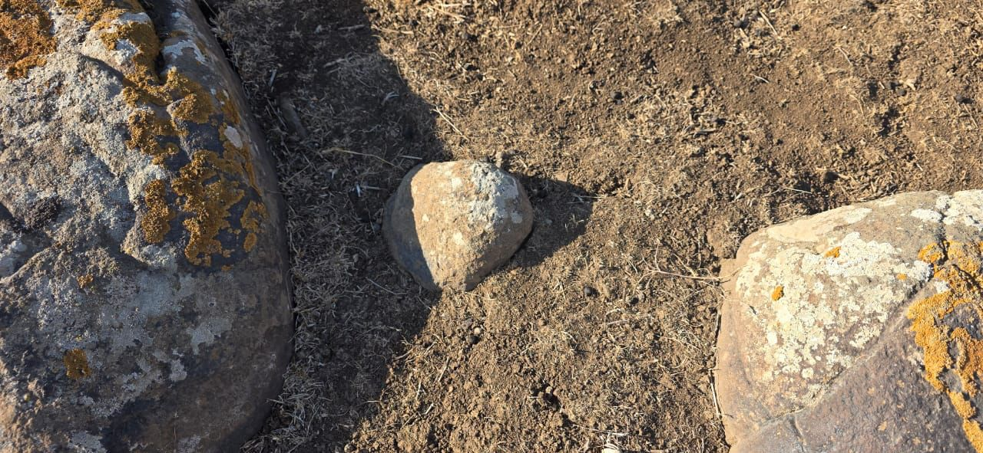
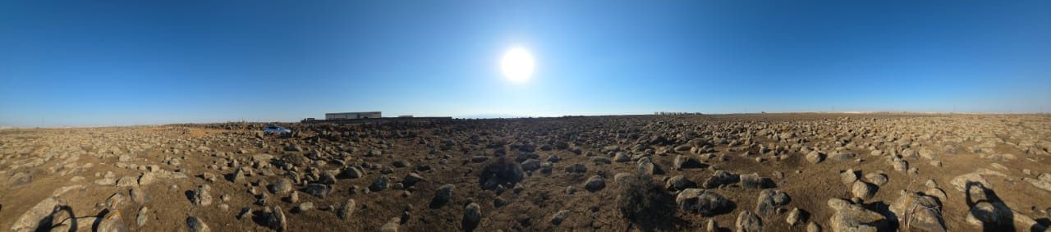
3.3 Pictures of Qattinah site (12/10/2025)
Picture Captured by Eng. Basem Alkahlil, Chief of the Wind Energy Department at the National Energy Research Center in Syria.
Sohil Mansuri

Slide 11
4. Overview of the selected parameters
Parameter | Value
Location | 34°40'22"N 36°35'59"E
Average Wind Speed | 8,64 m/s
Main Wind Direction | 270° (West) (more than 95% of the time)
Power density | 824 W/m^2
Wind Turbine Class (IEC) | II A
Grid Connection | 230 kV
Substation | 230 kV (approx. 2.5 km distance)
Air Temperature | ~ 20 °C max. 37 °C, low. 4 °C)
Humidity | Avg. 66 %
Air Pressure (Ground level) | 1017 mbar
Roughness length | 0.002
Orography (Terrain height) | 505 m
Environmental conditions | Mostly dry, Farmland, Flat Terrain
Road condition | M1 Road + (earthen road around 6km)
Distance to Port | 85.5 km (Tartous Port)
[1] [2] [3]
Sohil Mansuri

Slide 12
5.1 Roadmap – Detailed Site Analysis
1. Legal framework
→ Researching in detail on the regulation and guidelines in Syria
2. QGIS Analysis
3. Environmental Impact Assessment (EIA)
4. Land Leasing Agreements
5. Transportation Study
→ White mapping our location
→ Analysing the environment in detail
→ Analysing (assuming) the land rights for the site
→ Considering all the hurdles (Port, bridges, tight corners, road condition)
7. Conflict of Interests
→ Developing a Acceptance Strategy
6. Grid Connection Plan
→ Developing a plan for the cable route
Sohail Mansuri

Slide 13

5.2 Roadmap – WindPro Simulation
1. Project Setup
2. Wind Resource Data
3. Layout Design
4. Compliance Optimization
5. Final Calculation
Organising a License for WindPro
Area Definition
Measured Data (Met-Mast)
Reanalysis Data
MCP Analysis
Baseline Layout
Resource Mapping
Layout Optimization
Shadow Flicker Compliance
(Bird Protection Measures)
Loss and Uncertainty Analysis
Noise Compliance
Orography and Roughness Data
Sohail Mansuri

Slide 14
5.3 Roadmap – Economic (LCOE) Calculation
1. Setup of the calculation tool
2. Collection all the input parameters
3. “Estimating” all the costs
Need all the components costs from every team!
4. Simulating the AEP
5. Calculating the LCOE
By combining the AEP and the costs of the turbine
6. Final Economic Assessment
In regards of the power curve and wind data
In Excel, Matlab, Python
(DevEx), CapEx and OpEx
Calculating the performance and profitability
Sohail Mansuri

Slide 15
5.4 Timeline – Project Development Team
 |  | Milestone Plan of Team "Project Development"
Main Task | Description | OCT |  |  |  |  |  |  |  |  |  |  |  |  |  |  |  |  |  |  |  |  |  |  |  |  |  |  |  |  |  |  | NOV |  |  |  |  |  |  |  |  |  |  |  |  |  |  |  |  |  |  |  |  |  |  |  |  |  |  |  |  |  | Dec |  |  |  |  |  |  |  |  |  |  |  |  |  |  |  |  |  |  |  |  |  |  |  |  |  |  |  |  |  |  | Jan
 |  | 1 | 2 | 3 | 4 | 5 | 6 | 7 | 8 | 9 | 10 | 11 | 12 | 13 | 14 | 15 | 16 | 17 | 18 | 19 | 20 | 21 | 22 | 23 | 24 | 25 | 26 | 27 | 28 | 29 | 30 | 31 | 1 | 2 | 3 | 4 | 5 | 6 | 7 | 8 | 9 | 10 | 11 | 12 | 13 | 14 | 15 | 16 | 17 | 18 | 19 | 20 | 21 | 22 | 23 | 24 | 25 | 26 | 27 | 28 | 29 | 30 | 1 | 2 | 3 | 4 | 5 | 6 | 7 | 8 | 9 | 10 | 11 | 12 | 13 | 14 | 15 | 16 | 17 | 18 | 19 | 20 | 21 | 22 | 23 | 24 | 25 | 26 | 27 | 28 | 29 | 30 | 31 | 1 | 2 | 3 | 4 | 5 | 6 | 7 | 8 | 9 | 10 | 11 | 12 | 13 | 14 | 15 | 16 | 17 | 18 | 19 | 20 | 21 | 22 | 23 | 24 | 25 | 26 | 27 | 28 | 29 | 30 | 31
Site Selection | 1. genral site analysis + Wind ressource analysis
Detailed Site Analysis | 1. Legal Framework Analysis
 | 2. QGIS Analysis
 | 3. Environmental Impact Assessment
 | 4. Land Leasing Agreements
 | 5. Transportation Study
 | 6. Grid Connection Plan
 | 7. Conflict of Interests
WindPro Simulation | 1. Project Setup
 | 2. Wind Resource Data
 | 3. Layout Design
 | 4. Compliance Optimization
 | 5. Final Calculation
Economic LCOE Calculation | 1. Setup of the calculation tool
 | 2. Collecting all the input parameters
 | 3. Collecting all the cost of the components
 | 4. Simulating the AEP
 | 5. Calculating the LCOE
 | 6. Final Economic Assessment
Buffer Task | Buffer
 | Buffer
 | Buffer
Final presentation
Sohail Mansuri
Final presentation

Slide 16
Bibliography – Project Development
[1] Google, Google Maps. [Online]. Available: https://maps.google.com
[2] Google, Google Earth. [Online]. Available: https://earth.google.com/web/search/34%c2%b041%2749.6%22N+36%c2%b030%2730.0%22E/@34.67531382,36.5980701,506.39690821a,3513.70885844d,35y,360h,0t,0r/data=CiwiJgokCTkQ2iOXWkFAEQndzvkBWEFAGYw3RwMnREJAIQJ6D_SHPUJAQgIIAUICCABKCAjMjOyYBRAA
[3] Global Wind Atlas, Global Wind Atlas. [Online]. Available: https://globalwindatlas.info/en/.
[4] Open Infrastructure Map, OpenInfraMap. [Online]. Available: https://openinframap.org/#10.04/33.2058/36.2058.
[5] Shared files from the contact of Laurence Alhrshy. [Documets]
[6] Webull distribution finction and wind power statistics, ResearchGate. [Online]. Available: https://www.researchgate.net/publication/234452780_The_Weibull_distribution_function_and_wind_power_statistics
[7] „Introduction to wind turbine aerodynamics“, Alois Peter Schaffarczyk [online book].
Sohil Mansuri

